Slide 1


Git & GitHub
The reason developers don't cry over deleted files anymore.
Presenters: Abdullah & Ali Mustafa

Slide 2


THE PROBLEM
What happens when 5 developers edit the same file?
Without Git: Chaos
With Git: Harmony
Lost work, overwritten files, endless emails.
Controlled changes, clear history, efficient collaboration.

Slide 3

THE NEED
Why Version Control?
Code Overwrites
No History
Accidental data loss, endless frustration.
Can't revert to previous versions. Debugging nightmare.
Team Conflicts
Collaboration becomes a bottleneck, not a benefit.

Slide 4

UNDERSTANDING GIT
What is Git?
Version Control System
Tracks every change to your files, enabling seamless history and collaboration.
Full history on every developer's machine.
Tracks content, not just filenames.
Fast, efficient, and robust.

Slide 5




Git Architecture: The Three Trees
Working Directory
Local Repository
Staging Area
Git manages changes in three primary states, allowing precise control over what gets committed.
Working Directory
Staging Area (Index)
Local Repository
Your active project files; where you make changes.
A temporary area for preparing changes to be committed.
The history of your project, stored on your machine.

Slide 6

EXTENDING GIT
What is GitHub?
Remote Repository Hosting
A platform for hosting your Git repositories online, facilitating team collaboration and open-source contributions.
Centralized backup of your code.
Tools for code review and discussion.
Issue tracking and project management.

Slide 7






CORE GIT COMMANDS
Your Daily Toolkit
git init
git add
Initialize a new Git repository.
Stage changes for the next commit.
git commit
git branch
Save staged changes to the repository.
Manage divergent lines of development.
git merge
git push
Integrate changes from one branch into another.
Upload local commits to a remote repository.

Slide 8
COLLABORATION PATTERNS
Fork vs. Clone: When to Use Which
Purpose
Personal copy on GitHub
Local copy of a repo
Permissions
Full control of your copy
Inherits original repo access
Typical Use
Contributing to open source
Working on a team project
Relation
Separate project
Direct copy
Choosing the right method ensures smooth workflow and collaboration, especially in open-source projects.

Slide 9
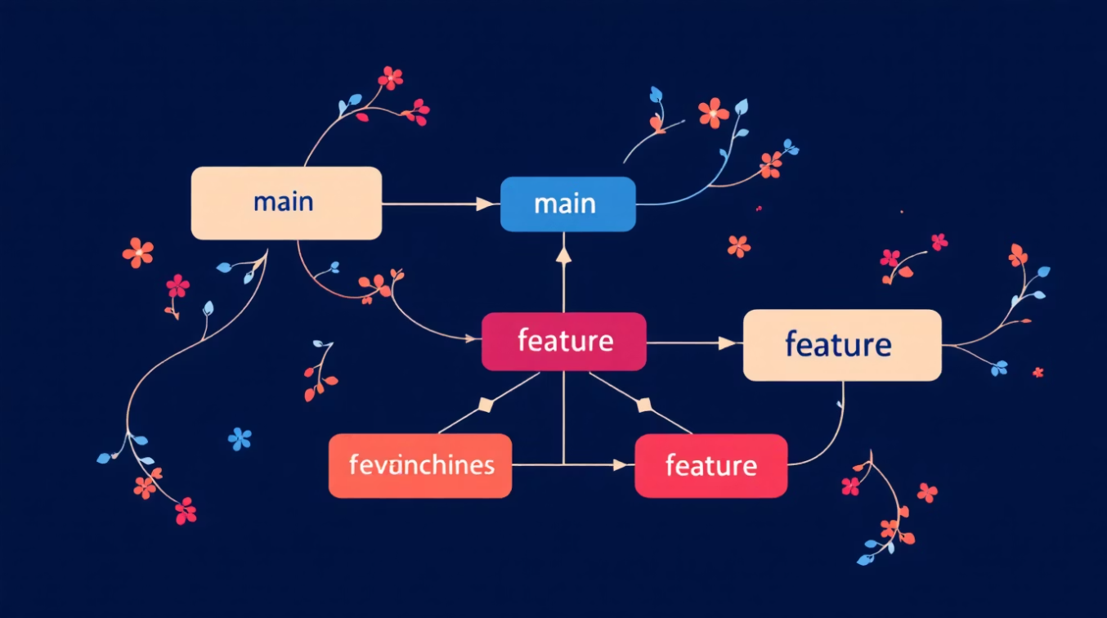
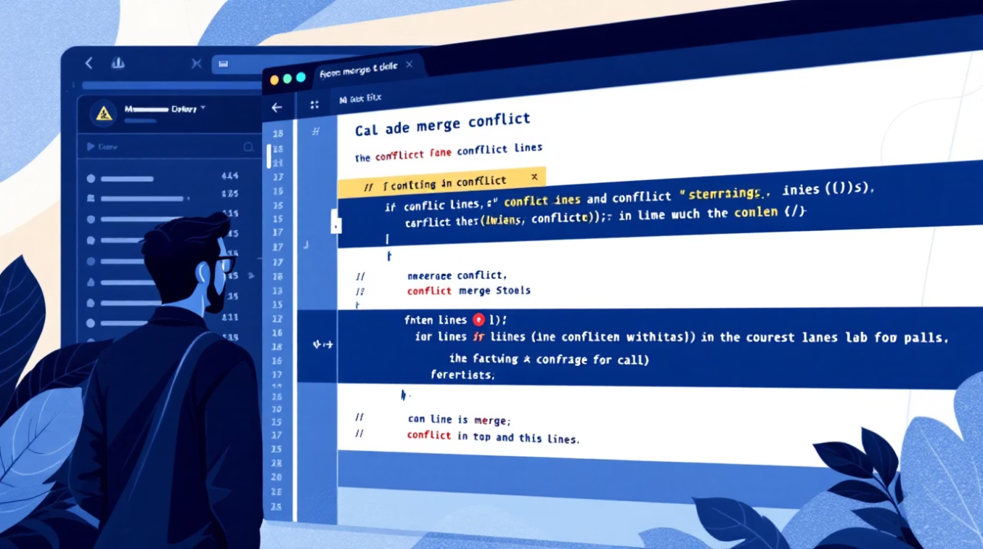
ADVANCED CONCEPTS
Branching & Merging
Parallel Development
Branches allow developers to work on features or fixes in isolation without affecting the main codebase.
Experiment safely with new ideas.
Manage multiple features simultaneously.
Facilitates code review via Pull Requests.
Merge Conflicts
When changes in different branches modify the same lines of code, Git can't automatically reconcile them. Human intervention required.
Identify conflicting lines.
Choose which changes to keep.
Mark as resolved and commit.

Slide 10


Git in the Real World
Industry Standard
Career Essential
Used in every major tech company.
Required for internships and jobs.
Open Source Power
Ethical Hacking
Fuels global collaboration.
Tool development relies on it.
If you're not committing your code, you're committing mistakes

